Slide 1
Biology
Unit 9: Patterns of Evolution
Lesson 2: Changes in Species
Notes:
The learning experiences in this unit prepare students for the mastery of
Performance Expectations
LS1-2 Develop and use a model to illustrate the hierarchical organization of interacting systems that provide specific functions within multicellular organisms.
LS1-3 Plan and conduct an investigation to provide evidence that feedback mechanisms maintain homeostasis.
ETS1-2 Design a solution to a complex real-world problem by breaking it down into smaller, more manageable problems that can be solved through engineering.
ETS1-3 Evaluate a solution to a complex real-world problem based on prioritized criteria and trade-offs that account for a range of constraints, including cost, safety, reliability, and aesthetics, as well as possible social, cultural, and environmental impacts.

Slide 2

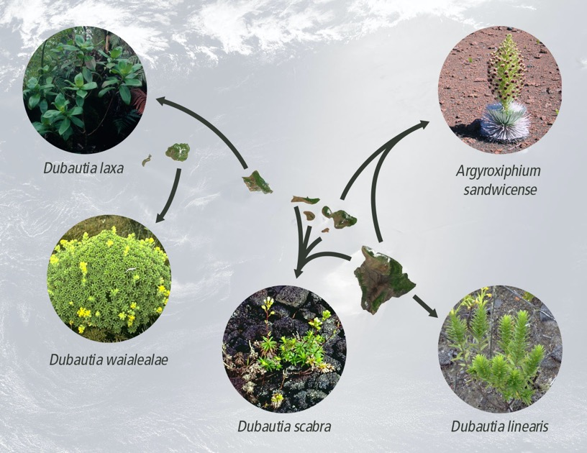
Can You Explain It?
Unit 9 Lesson 2
These plants have a common ancestor. How did they develop different characteristics?
GATHER EVIDENCE
As you explore the lesson, gather evidence that supports the claim that changes in environmental conditions result in the emergence of new species over time and the extinction of other species.
Plants in the silversword alliance are closely related and yet show remarkable diversity.
Notes:
Build on Prior Lessons
In Lesson 1, students learned about factors that affect genetic variation and evolution of populations. Lesson 2 builds on these concepts as students explore speciation and species expansion and extinction.
Lesson Objective
Explore how changes in environmental conditions can lead to the emergence, expansion, or extinction of species.

Slide 3
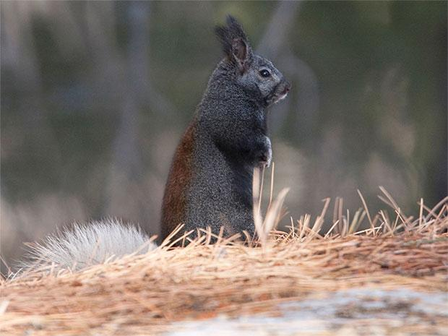
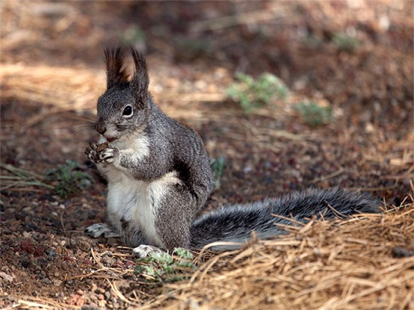
Unit 9 Lesson 2
Mechanisms of Speciation
A species is a group of similar organisms that can breed and produce fertile offspring.
The millions of species that live on Earth today emerged over time, with each new species arising from an already existing species.
COLLABORATION
Kaibab and Abert's squirrels live on opposite sides of the Grand Canyon. Though closely related, they do not share all of the same characteristics. How did these differences come about? Make a list with a partner to explain your reasoning.
Kaibab squirrel
Abert’s squirrel

Slide 4
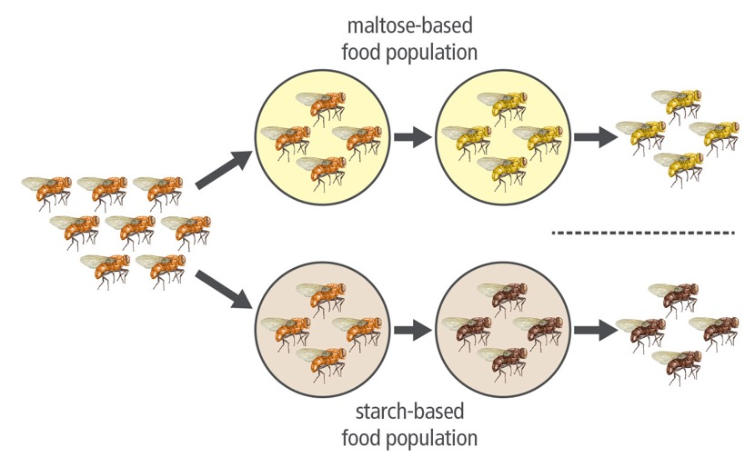
Unit 9 Lesson 2
Mechanisms of Speciation
Speciation is the rise of two or more species from a single existing species. Experiments can be used to model speciation.
What happened during the many generations that these flies were kept separated?
How might this period of isolation have contributed to the mating preferences shown?
Changes in fruit flies can occur due to differing food sources.

Slide 5
Unit 9 Lesson 2
Mechanisms of Speciation
If gene flow is interrupted between two populations of the same species, the populations are said to be isolated.
Isolated populations are prevented from mating and exchanging genes. This means natural selection acts upon a different gene pool for each population.
Reproductive isolation occurs when members of different populations can no longer mate successfully. Sometimes members of the two populations are not physically able to mate with each other.
In other cases, they cannot produce offspring that survive and reproduce. Reproductive isolation is the final step of becoming a separate species.

Slide 6
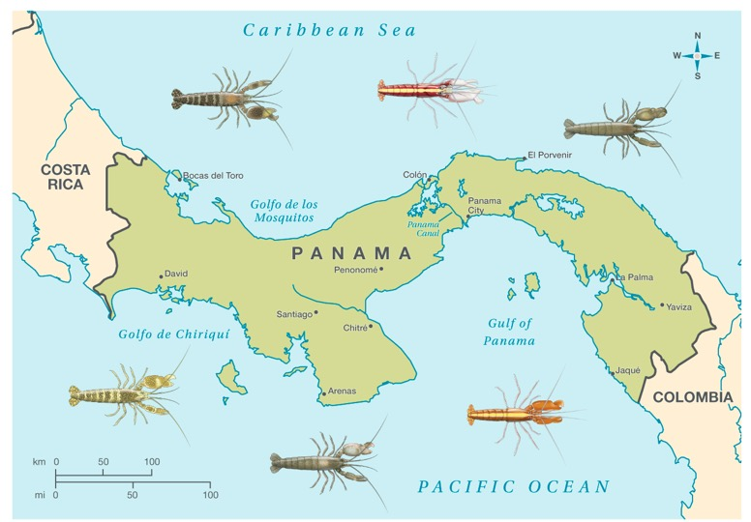
Unit 9 Lesson 2
Mechanisms of Speciation
The physical separation of two or more populations can lead to speciation through geographic isolation.
COLLABORATE
With a partner, make a list of other physical barriers that can lead to geographic isolation as happened with snapping shrimp.
Speciation in snapping shrimp occurred due to geographic isolation.

Slide 7
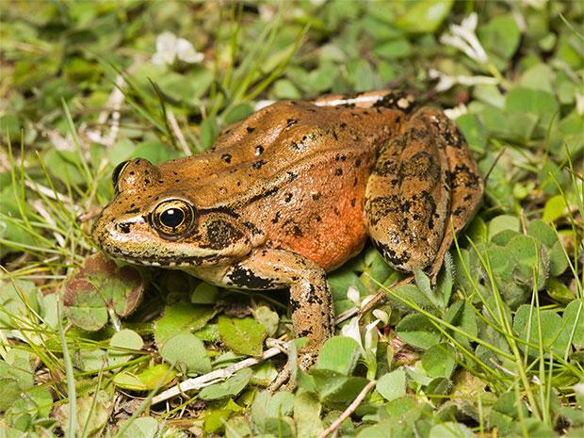
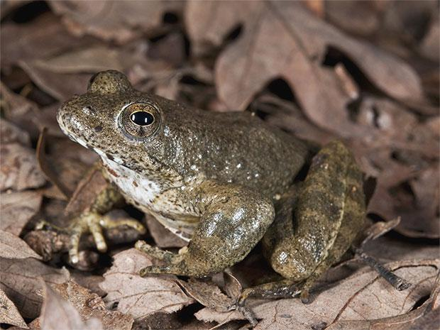
Unit 9 Lesson 2
Mechanisms of Speciation
Behavioral isolation is caused by differences in courting or mating behaviors.
If two populations do not use the same courting or mating behaviors, then mating, and therefore gene flow, between the two groups is unlikely to occur.
Why does having different mating seasons lead to speciation within a population?
Red-legged Frog
Yellow-legged Frog

Slide 8

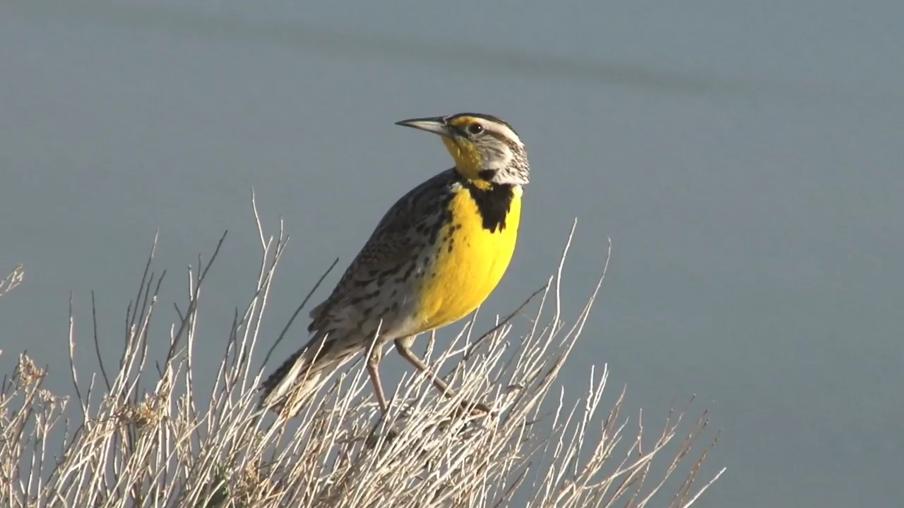
Unit 9 Lesson 2
Mechanisms of Speciation
Eastern meadowlark

Slide 9
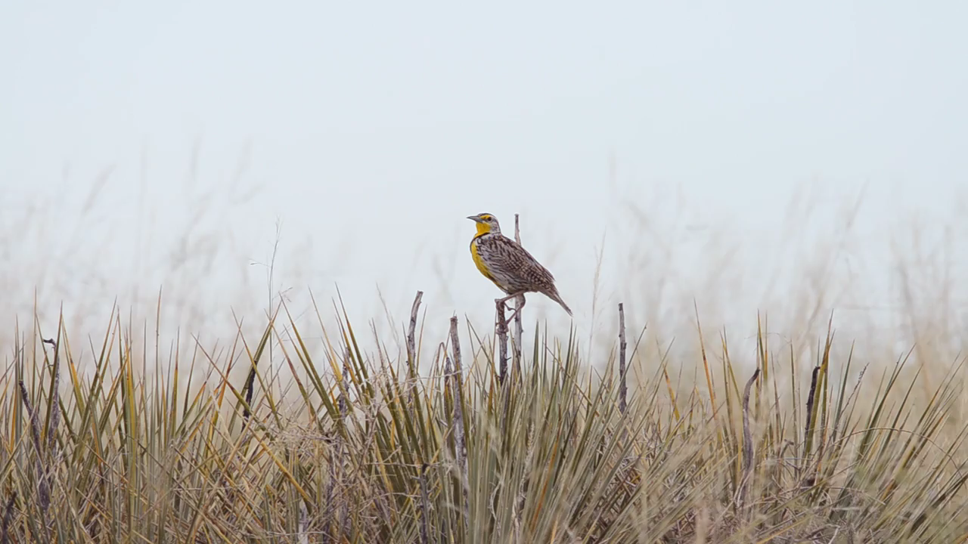
Unit 9 Lesson 2
Mechanisms of Speciation
Western meadowlark

Slide 10
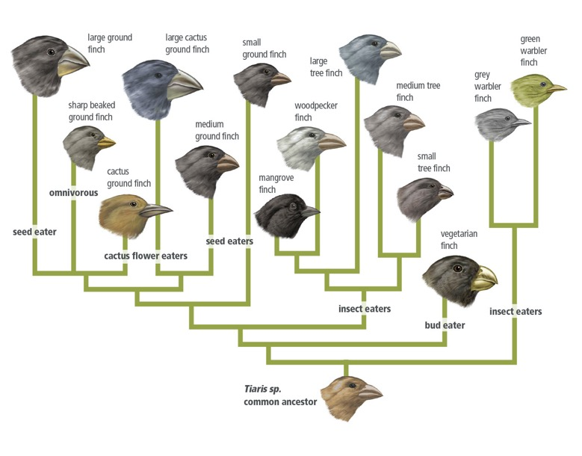
Unit 9 Lesson 2
Mechanisms of Speciation
Speciation through the diversification of one ancestral species into many descendant species is called adaptive radiation.
Adaptive radiation typically happens quickly as species benefit from less competition, new niches, or specializations that give a selective advantage.
For adaptive radiation to take place, there must be adaptation by a species that leads to speciation.
The diverse finches of the Galápagos Islands came from a common ancestor.

Slide 11
Unit 9 Lesson 2
Mechanisms of Speciation
EXPLAIN
Which type of reproductive isolation could have led to the speciation of plants in the silversword alliance? Use evidence to support your claim.

Slide 12
Unit 9 Lesson 2
Expansion of Species
Natural environmental changes such as droughts can lead to the expansion of a species' range.
For example, a long-lasting drought can change an ecosystem to make it more suitable for plants adapted to dry conditions. These plants could expand into the ecosystem and outcompete plants that are less well adapted to the dry conditions.
Humans can also cause environmental changes that lead to the expansion of species.

Slide 13
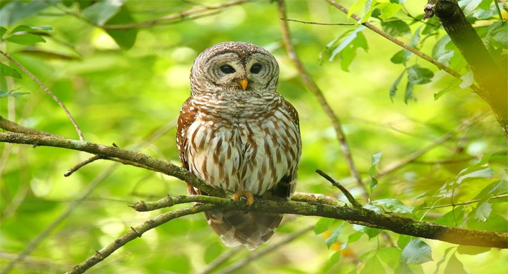
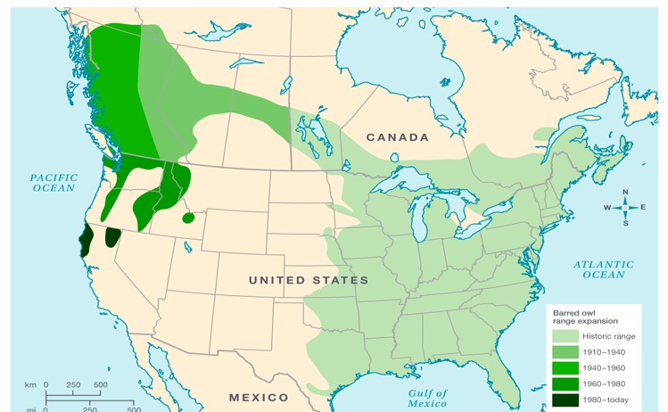
Unit 9 Lesson 2
Expansion of Species
Historically, the barred owl lived in the eastern United States.
Much has changed in these ecosystems over the past 100 years.
Environmental changes are potential causes for the barred owl range expansion across British Columbia in Canada into Washington, Oregon, and Northern California in the Pacific Northwest region of the United States.
Barred owls have benefited from environmental changes that led to an increase in suitable habitat.

Slide 14
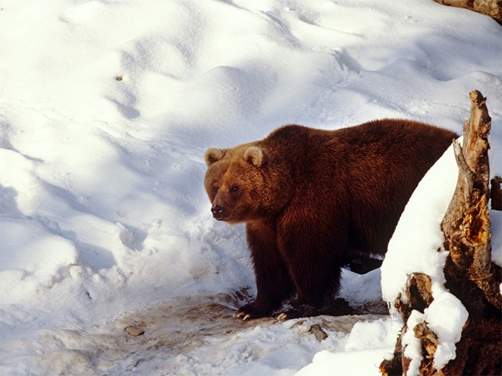
Unit 9 Lesson 2
Expansion of Species
Climate change is affecting different areas in different ways.
As areas warm, they may become more suitable for organisms that were previously kept out due to uninviting habitat conditions.
The expansion of species into new territories can also lead to hybridization. Hybridization occurs when two distinct, but closely related, species are able to successfully mate.
Grizzly bears have expanded their range into polar bear habitat.

Slide 15
Unit 9 Lesson 2
Expansion of Species
EXPLAIN
How would population expansion most likely occur in the silversword alliance, assuming these plants underwent adaptive radiation?

Slide 16
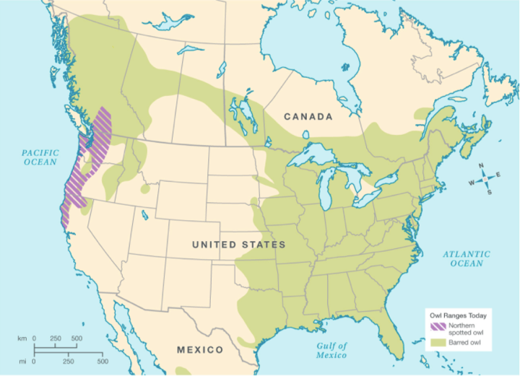
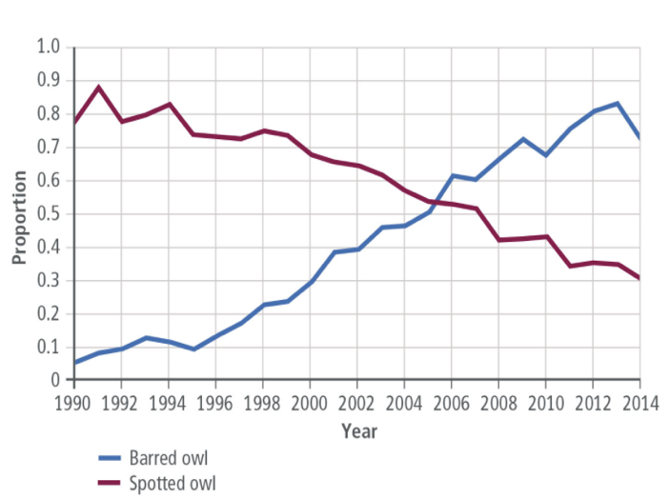
Unit 9 Lesson 2
Extinction of Species
Northern Spotted Owl and Barred Owl Territory | The barred owl range has expanded to cover most of the northern spotted owl range in the Pacific Northwest.
Owl Populations | Competition for resources has increased with the increasing barred owl population in the Pacific Northwest.
COLLABORATE
Discuss with a partner how the expansion of a species into a new habitat might affect native species that are already living there.

Slide 17
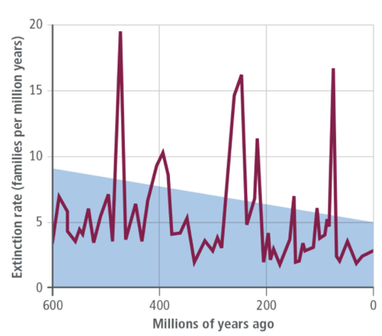
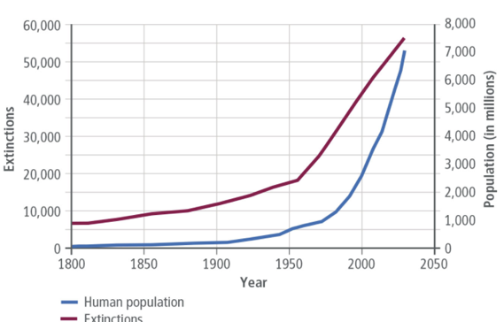
Extinction of Species Cause and Effect
Unit 9 Lesson 2
EXPLAIN
Use the graphs to answer the following questions in your Evidence Notebook.
What patterns or trends are shown in the Extinction Rates Through Time graph? What is the cause of these patterns?
What patterns or trends are shown in the Humans and the Extinction Crisis graph? What is the cause of these patterns?
Is there a relationship between the two graphs? Explain your answer.
Extinction Rates Through Time
Humans and the Extinction Crisis

Slide 18
Unit 9 Lesson 2
Extinction of Species
Many scientists think that Earth is currently experiencing a sixth mass extinction. The sixth mass extinction is characterized by extinction rates that are 1000 to 10,000 times the background rate.
The current extinction event is caused almost entirely by human behaviors such as the burning of fossil fuels, destruction of habitat, and introduction of invasive species.
Climate change is caused by the release of large amounts of greenhouse gases—such as carbon dioxide—into the air, mostly from the burning of fossil fuels.
Other species may go extinct if their populations cannot adapt quickly enough to the changing environmental conditions.

Slide 19
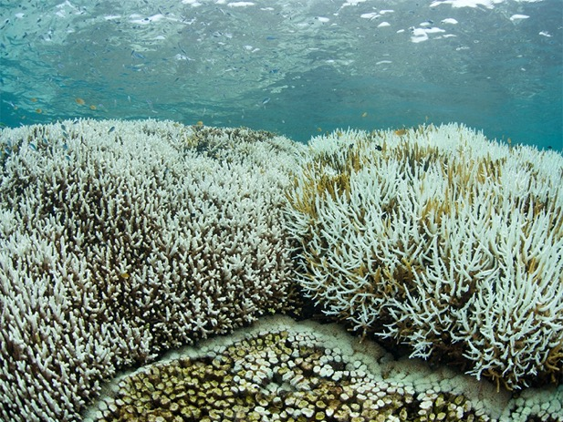
Unit 9 Lesson 2
Extinction of Species
Rising sea temperatures are the leading cause of coral bleaching.
Ocean acidification occurs when carbon dioxide is absorbed by seawater. The reaction results in a decrease of carbonate which coral reefs need to survive.
Many coral reefs are located in areas with extreme weather events. It is predicted that climate change will increase the frequency and intensity of severe storms.
Coral bleaching is a stress response in corals.
EXPLAIN
What might happen if a species that is well adapted to lower pH and higher temperatures was introduced to coral reefs in the Hawaiian Islands?

Slide 20
Unit 9 Lesson 2
Continue Your Exploration
Choose one of the paths below to continue your exploration:
Career: Bioinformatics
Patterns in Evolution and Speciation
Mimicry
Hybridization

Slide 21
Can You Explain It?
Unit 9 Lesson 2
The plants in the silversword alliance have a common ancestor. Refer to the notes in your Evidence Notebook to explain how they developed different characteristics. In your answer, consider how changes or differences in the environment affect the emergence and disappearance of species.

Slide 22
Image Credits
Unit 9 Lesson 2
Dubautia laxa ©Mark W. Skinner at USDA-NRCS PLANTS Database; Argyroxiphium sandwicense ©National Park Service, Hawaii Haleakala National Park; Dubautia waialealae Photo by A. C. Medeiros, courtesy of Smithsonian Institution; Dubautia scabra Photo by J. Price, courtesy of Smithsonian Institution; Dubautia linearis Photo by J. Price, courtesy of Smithsonian Institution; Eastern meadowlark singing video ©RCMarx/Shutterstock; Western meadowlark singing video ©David Spates/Shutterstock; red-legged frog ©Chris Mattison/Alamy; yellow-legged frog ©Vibe Images/Fotolia; barred owl ©donyanedomam/Fotolia; grizzly bear ©Photo by Hoberman Collection/UIG via Getty Images; dying coral reef ©Ethan Daniels/Shutterstock

